Slide 1
The internet is also an effective way of extending marketing, advertising, and brand reach
Strategies
Theme/Concept
Example
Cross-Channel Sales and Marketing
Providing cross-channel sales and marketing opportunities to drive customers from the Web to stores / catalog, and vice-versa
The Gap
Eddie Bauer
Spiegel
Customer Value Management & Relationship Marketing
Using one-to-one marketing to send customized messages / offers to customers on items that are selected specifically for them based on their individual purchase history and explicit preferences.
Spiegel
iQVC
CDNow
Building Communities of Interest
Leveraging consumer interest in a specific topic into an on-line community, where consumers interact with the merchant based on topic, rather than on a specific product / service offer
dELiA’s
Garden Escape
The Knot
Borders
Providing Related Content
Offering proprietary or co-branded content (e.g. buying guides, editorials, entertainment, etc.) that complements the core product / service offer, helping to deepen the customer relationship and brand association.
Travelocity
Leisure Planet
LL Bean
Extending Brand Reach
Attracting new markets, demographics, and consumers by leveraging an existing brand to a new medium
The Gap
Nordstrom
Gateway

Slide 2
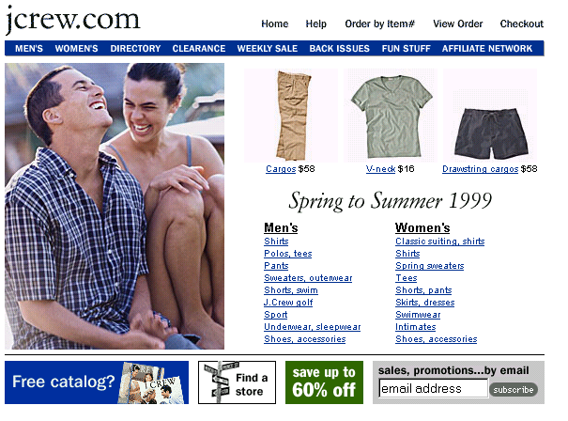
E-Biz Opportunity: Extending Marketing/Advertising/Brand Reach; Cross-Channel Sales and Marketing
Website example: www.jcrew.com
URL: http://www.jcrew.com
Link to the J.Crew catalog
J.Crew Store locator

Slide 3
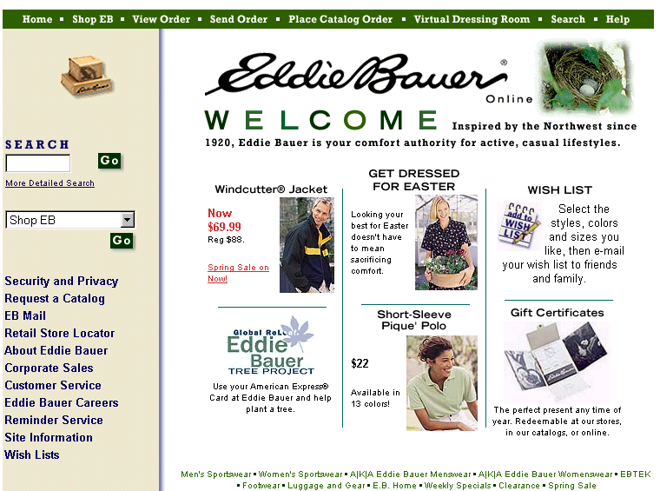
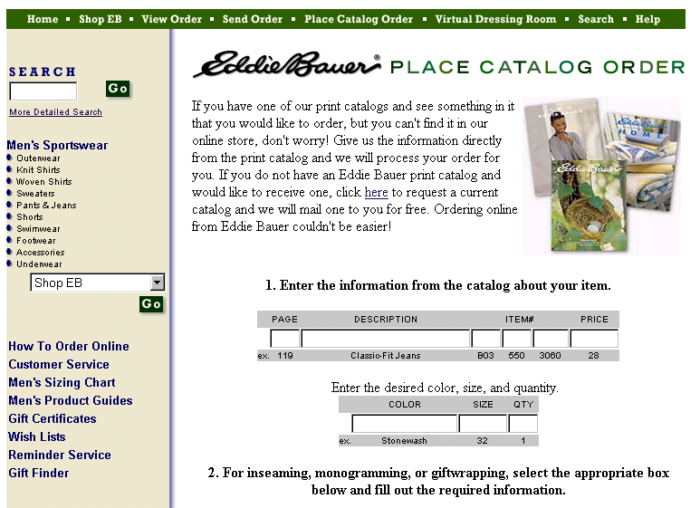
E-Biz Opportunity: Extending Marketing/Advertising/Brand Reach; Cross-Channel Sales and Marketing
Website example: www.eddiebauer.com
URL: http://www.eddiebauer.com/v_dressingroom/vdr/frame_vdr.asp
Place catalog order on navigation bar.
Can place catalog orders on Eddie Bauer’s website.

Slide 4
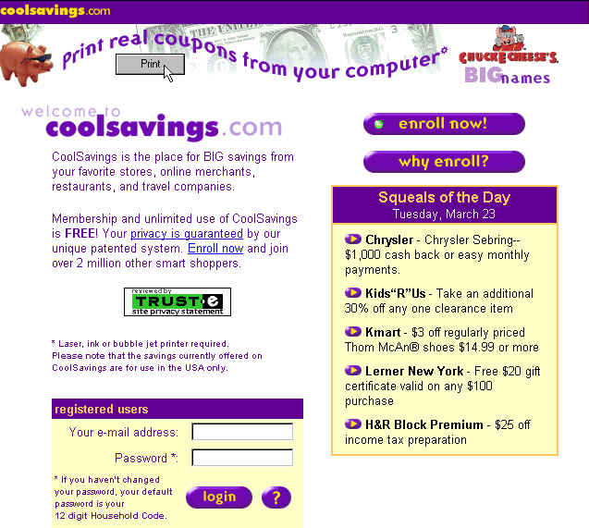
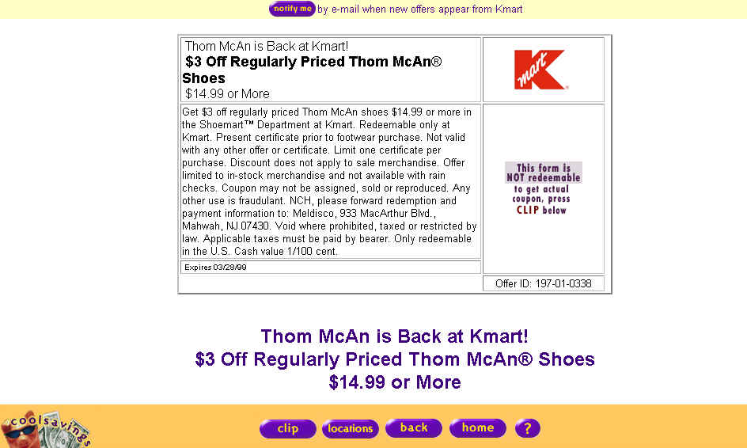
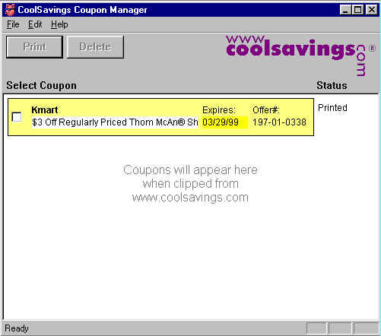
E-Biz Opportunity: Extending Marketing/Advertising/Brand Reach; Cross-Channel Sales and Marketing
Website example: www.coolsavings.com
URL: http://www. www.coolsavings.com
Print coupons from the website to be redeemed in regular brick and mortar stores.
After hitting clip, this pop-up window appears. The downside is that the consumer has to download this Cool Savings program in order to print out the coupon.
The consumer can print the coupon or delete it.
The Clip button allows the customer to print out the coupon.

Slide 5
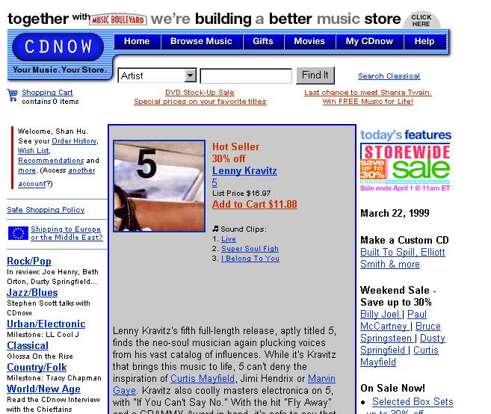
E-Biz Opportunity:Extending Marketing/Advertising/Brand Reach;Customer Value Mgmt and Relationship Mkting
Website example: www.cdnow.com
URL: http://www.cdnow.com
Customer’s name
Special Lenny Kravitz promotion based on the customer’s profile.
Weekend Sale special also based on customer’s profile.

Slide 6
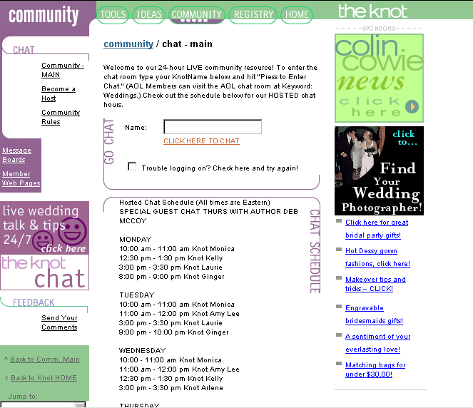
E-Biz Opportunity: Extending Marketing/Advertising/Brand Reach;Building Communities of Interest
Website example: www.theknot.com
URL: http://www7.theknot.com/registry.html
Community clearly labeled.
Chat entrance
24/7 Chat on wedding talk and tips
Chat schedule

Slide 7
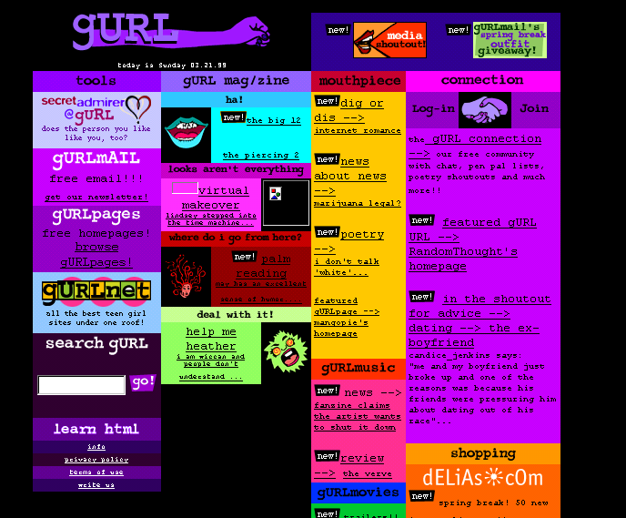
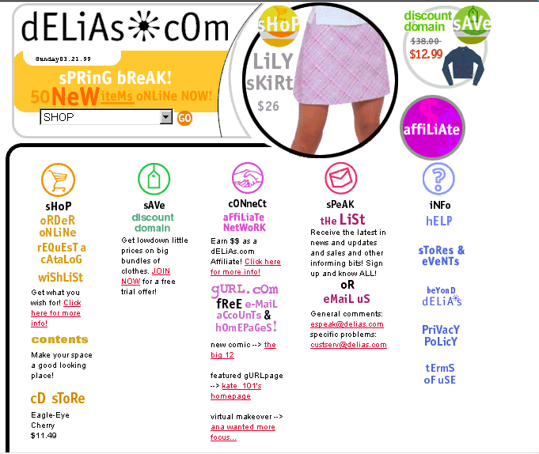
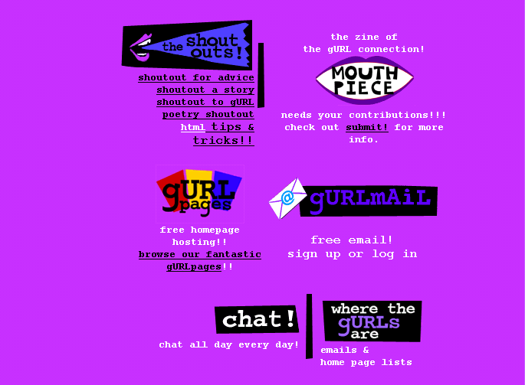
E-Biz Opportunity: Extending Marketing/Advertising/Brand Reach;Building Communities of Interest
Website example: www.delias.com
URL: http://www.delias.com
Gurl.com offers chat, free email, personal WebPages and more.
Delia’s link to Gurl.com.
Web pages
Email
Chat

Slide 8
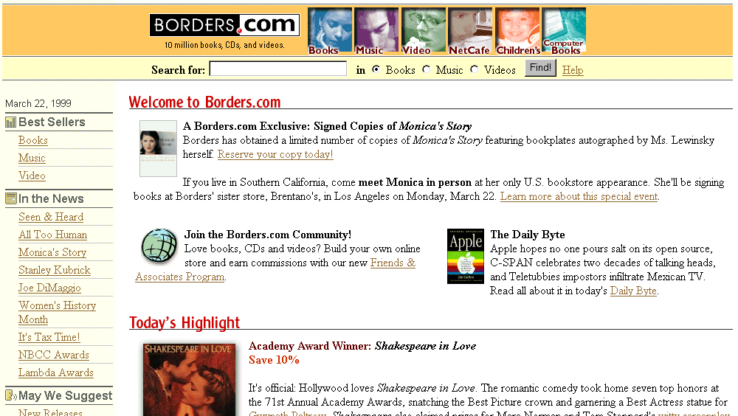
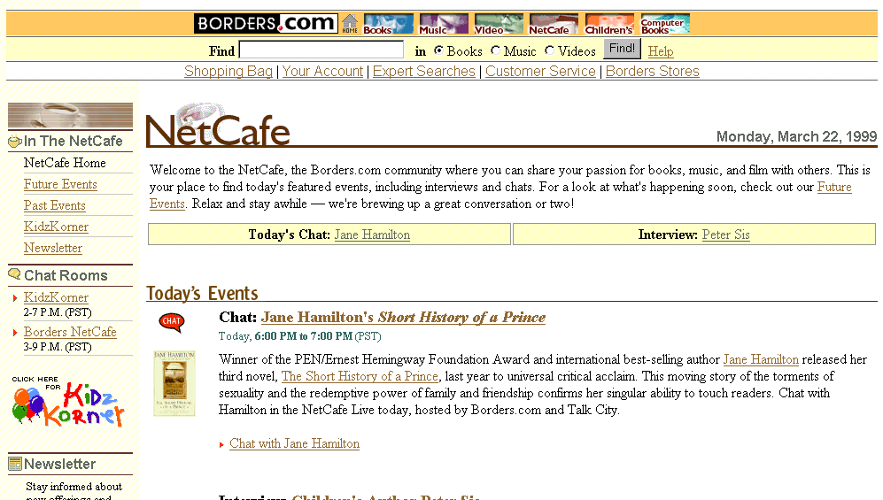
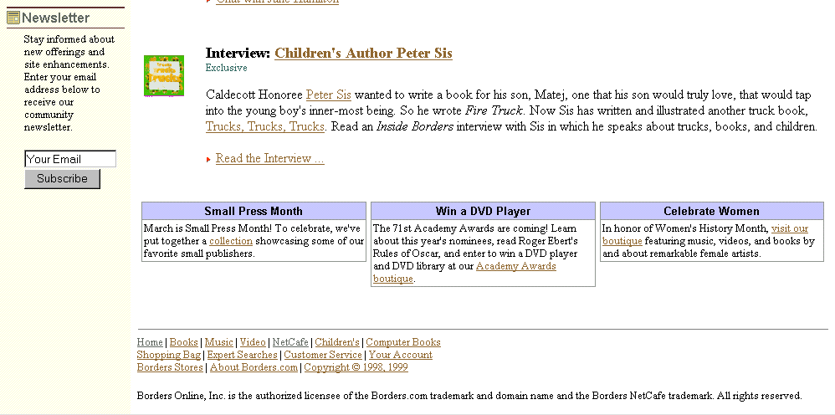
E-Biz Opportunity: Extending Marketing/Advertising/Brand Reach;Building Communities of Interest
Website example: www.borders.com
URL: http://www.borders.com
Events Past and Present
Chat Rooms
Today’s events
Offer to join the community
Newsletters

Slide 9
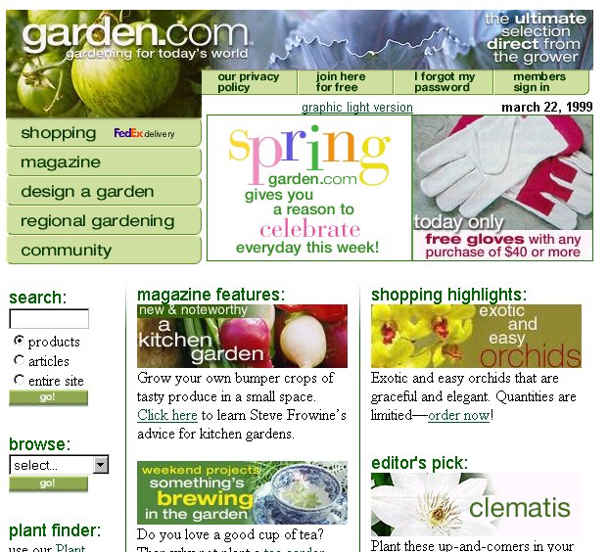
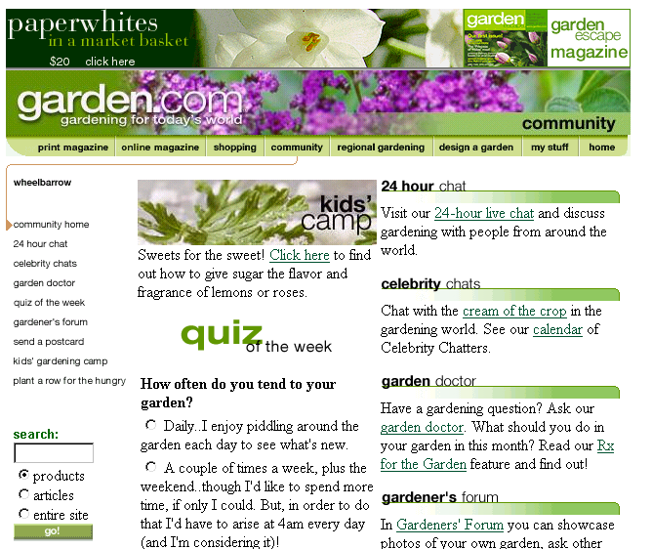
E-Biz Opportunity: Extending Marketing/Advertising/Brand Reach;Building Communities of Interest
Website example: www.garden.com
URL: http://www.garden.com
Community section
Community on navigation bar
24 hour chats
Celebrity Chats
Garden Doctor
Fun and Games - quiz of the week
Gardener’s Forum

Slide 10
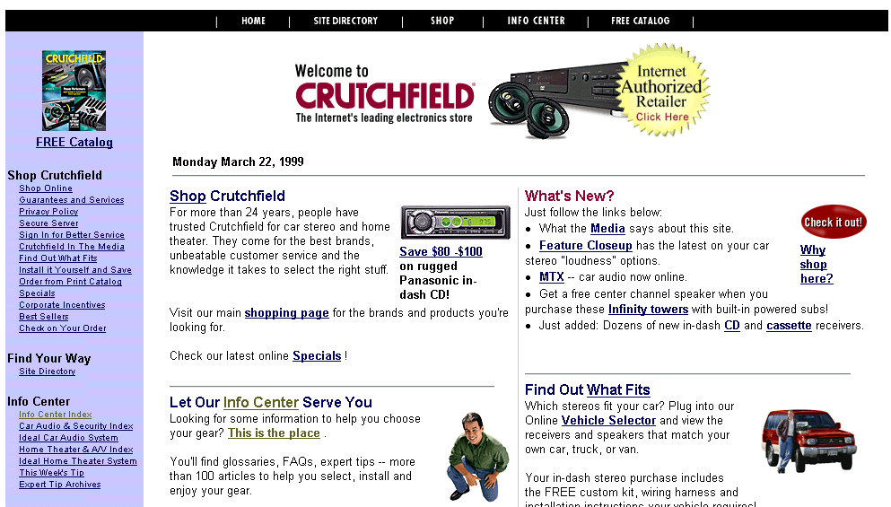
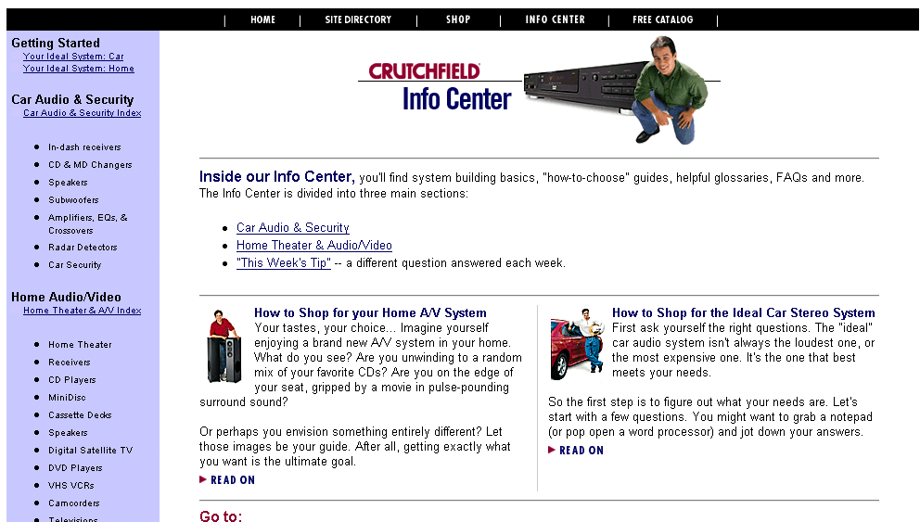
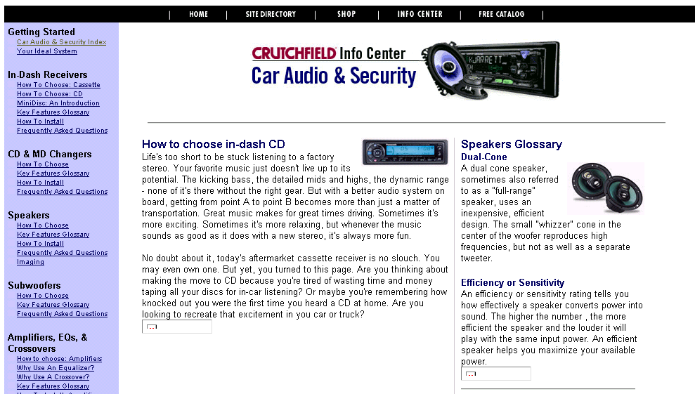
E-Biz Opportunity: Extending Marketing/Advertising/Brand Reach;Providing Related Content
Website example: www.crutchfield.com
URL: http://www.crutchfield.com
Related content: How-to information
Info Center

Slide 11
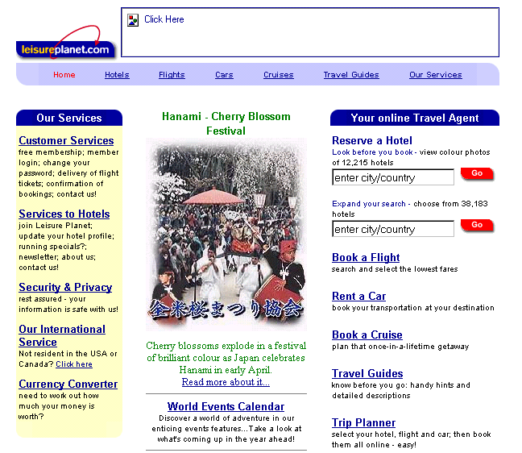
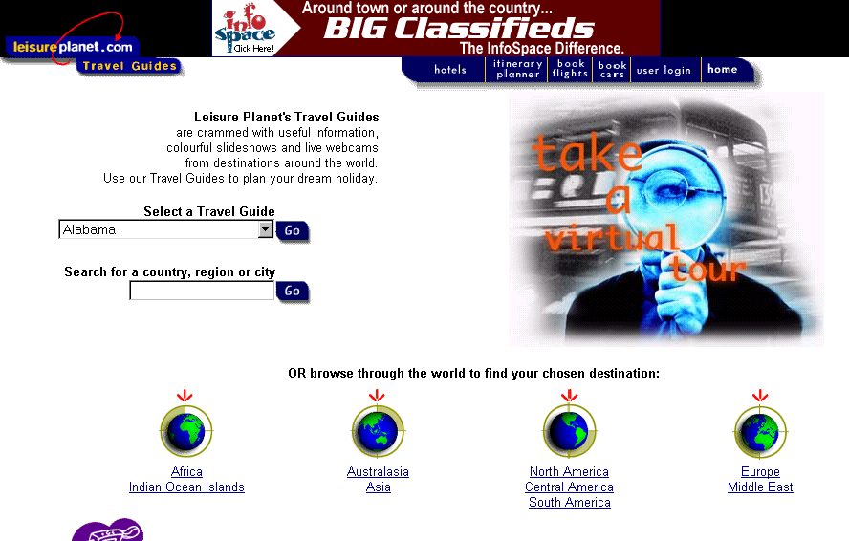
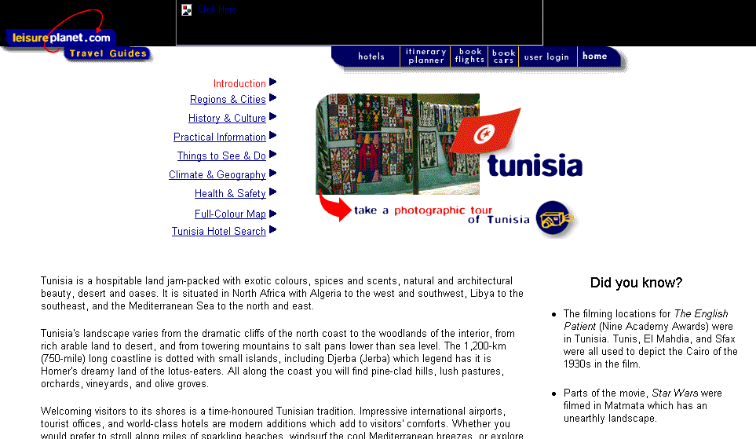
E-Biz Opportunity: Extending Marketing/Advertising/Brand Reach;Providing Related Content
Website example: www.leisureplanet.com
URL: http://www.leisureplanet.com
Services to hotels.
Tour Guide Selector (ex. Tunisia)
Currency Converters
Numerous topics related to Tunisia
Photographic Tour link
“Did you know”information.

Slide 12
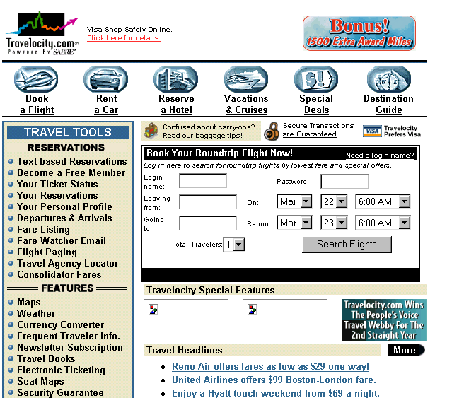
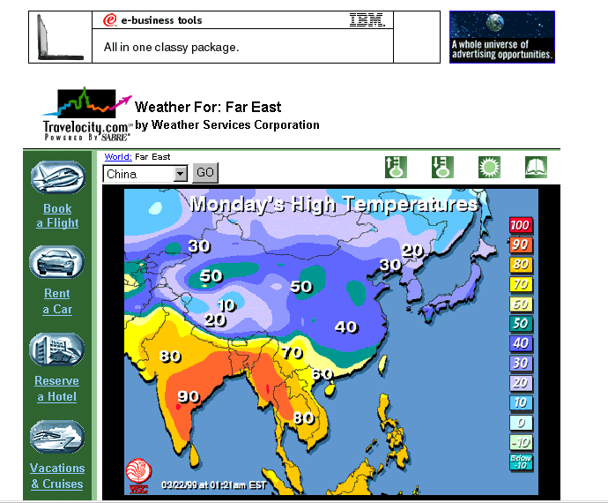
E-Biz Opportunity: Extending Marketing/Advertising/Brand Reach;Providing Related Content
Website example: www.travelocity.com
URL: http://www.travelocity.com
Weather service provided by Weather Services Corporation
Maps
Weather
Currency Converter
Travel books

Slide 13
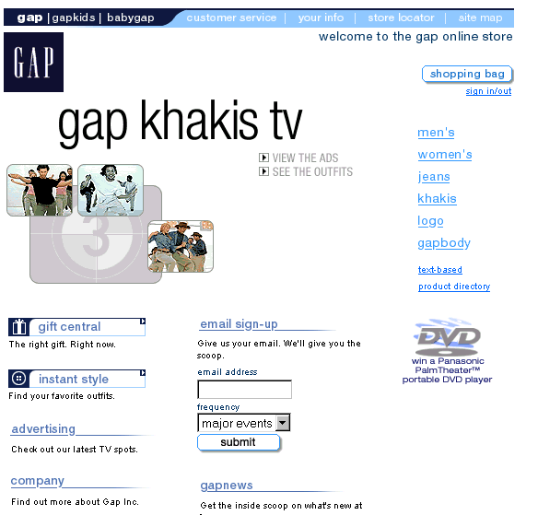
E-Biz Opportunity: Extending Marketing/Advertising/Brand Reach; Extending Brand Reach
Website example: www.gap.com
URL:http://www.gap.com
Option to view TV ads
Graphics based on Gap’s TV ads.
More on advertising and extending the Gap brand.

